Slide 1

Making A Difference

Slide 2


Smelly Washrooms, Blocked Pipes?
Use Biologicals!
…….IT WORKS
&
It’s Nature’s own Solution
..it’s that simple!

Slide 3
The Biological Story
Bacteria can be classified by their habits as they relate to human activities. The overwhelming majority of bacteria are harmless to humans. These bacteria are important to humans because they play a role in the ecology of life, by decomposing wastes, both natural and man-made.
The use of bacteria to treat problems(Bioremediation) has existed in the world since approximately 600BC, this process is believed to have involved the ancient Roman's utilisation of micro organisms to treat their waste water.
It has been used in pest control since the 1890’s. For example, Bacillus thuringiensis (Bt) is a naturally occurring bacterial disease of insects. These bacteria are the active ingredient in some insecticides. Bt acts by producing proteins (delta-endotoxin, the "toxic crystal") that reacts with the cells of the gut lining of susceptible insects. These Bt proteins paralyze the digestive system, and the infected insect stops feeding within hours. Bt-affected insects generally die from starvation, which can take several days.
The right strains of bacteria have been applied to biological cleaning products for use in washrooms, treating urine contaminated carpet and other organic contamination. Likewise specific strains are used in grease traps, septic systems & water treatment.
Applied where urine or organic waste contamination exists, the right biological product and process will fix the problem and not mask it as is the usual approach delivered by cleaning companies using the “me too” chemicals readily available and promoted.
What differentiates biological treatment to normal cleaners and cleaning is – IT WORKS. It deals with the problem in an environmentally friendly way, using natural processes that are proven.
Bio-Productions Ltd originated the biological urinal block in the 1990’s. Since then it has been widely copied.
With its commitment to develop and deliver safe, effective and environmentally friendly cleaning products, Bio-Productions Ltd has earned a reputation as a leading proponent on the world stage and has been awarded accordingly.
“Some bacteria have the capacity to stabilise uranium contaminated sites, and if they are used they could reduce the chances of these sites contaminating major waterways and ecosystems, U.S. scientists have said.” – Gemma Black (Cosmos online)

Slide 4
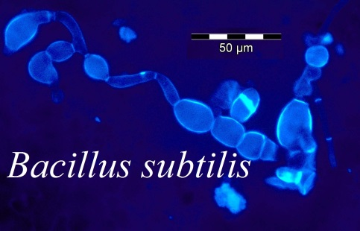
How Does Biological Work?
Odours come from Bad Bacteria colonising contaminated surfaces
Good Bacteria colonise surfaces and multiply – eliminates food source, starving Bad Bacteria – they die
Bacteria
  multiply every 12 min
  Create their own enzymes – breaks molecular bonds
  Absorbs the changed structure = food source
Biological products have been used for decades

Slide 5
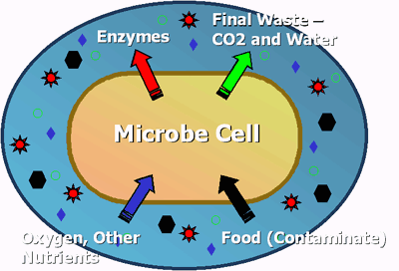

Washroom surface contaminated with organic waste = SMELL
Bacteria selected to deal with the specific waste problem = CORRECT TOOL
Bacteria release specific enzyme to break the molecular bonds of the waste
Bacteria feed off the changed structure – creating more enzymes = ENZYME FACTORY
Waste is reduced
Odour is ELIMINATED
Correct solution for the Problem = FIXED

Slide 6

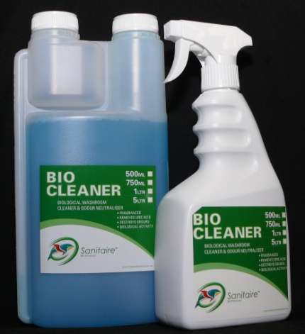
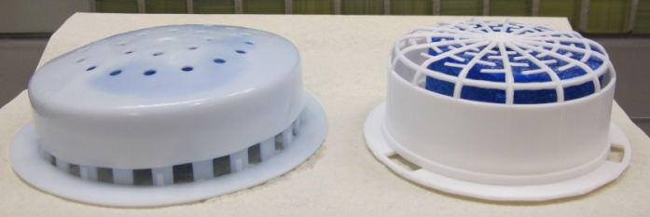
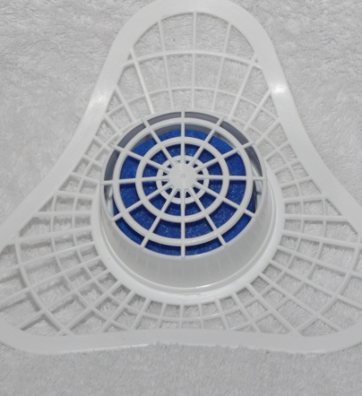
The Products manufactured by Bio-Productions Ltd recipient of a 2011 UK Green Apple Award
BioCAPs with 29/30gm Bio Block
Biological Cleaner – 750ml, 1ltr, 5ltr bulk
BioScreens with 88gm Bio Block

Slide 7

A Point of Difference Story?
Hi Gene
My apologies for the late response I won’t bore you with the details.
I just need to let you know the latest from the installation of your Sanitaire Flick line of products here at South Bank.
As you know South Bank Corporation had been using the services of (a national washroom service provider – name withheld) for the waterless urinals situated in South Bank and the Little Stanley St precinct. From the outset there were continuous issues with servicing of the units by (a national washroom service provider – name withheld) A service schedule had been set up by the company but once the units were in there was one monthly service that seemed to be very superficial to say the least. After the initial service it became obvious that the system or inserts were not sealed properly and were extremely difficult to clean and maintain. The product provided (when it was finally delivered) did nothing to help the situation as the build up and smell in certain urinals was becoming unbearable.
The frustration for the South Bank Operations team was that even with repeated requests for (a national washroom service provider) to address these problems they did not appear on site. In the end ISS were asked to source a replacement.
From the initial installation of Sanitaire products there was an instant change to the units in how they operated and smelt. The Biological Cleaner has made a huge difference to three of our troublesome toilet blocks that are constantly busy, one of these is situated in an area surrounded by Restaurants with spicy menus. Prior to Sanitaire you could hardly breathe in these blocks. The Bio blocks are very economical to use and the South Bank plumbers think the product is fantastic to work with. We have recently ordered several more of the sleeves so the plumbers now rotate the units as they are very easy to clean and replace.
Once again as per our phone conversations many thanks for the products and service you have provided.
Regards
Pat
Patrick Farley | ISS Facilities Services
South Bank Corporation | Mezzanine Level, Allgas Building | Stanley Street Plaza
PO Box 2001 | South Bank | Queensland 4101
Telephone 07 3867 2061 | Mobile 0478304998
www.southbankcorporation.com.au | iss@south-bank.net.au

Slide 8

Testimonial
GREEN APPLE AWARD FOR GATWICK
In a national campaign to find Britain’s greenest companies, councils and communities, Bio-Productions, in partnership with OCS, have won a Green Apple Environment Award for helping to reduce the environmental impacts of cleaning Gatwick, the UK's second largest airport. The Green Apple Awards are run by The Green Organisation to recognise, reward and promote environmental best practice around the world.
The awards will be presented to winners at a ceremony in the House of Commons on November 14, 2011. They are invited to have their winning paper published in The Green Book, the leading international work of reference on environmental best practice, and will also be considered to represent their country in the European Business Awards for the Environment.
The introduction of Bio-Productions biological cleaning products at Gatwick has resulted in a recognised improvement in washroom air quality, as well as the airport’s environmental impacts being reduced in a number of ways. A reduction in chemical use has led to fewer deliveries and less on-site stock movement, with an anticipated saving of approximately 100 truck miles a year. Bio-Productions biological urinal blocks have been introduced in all the washrooms, bringing an annual reduction in water usage of around 100,000 litres per annum as well as energy savings on pumping and moving water to the airport’s effluent treatment plant. The cleaning products are also stored in a smaller area resulting
in lower energy consumption.
Adrian Shuker, Sustainability Director for OCS who provide cleaning services in the airport’s public areas, commented: “It has been one of our top priorities to enhance the passenger experience, especially in the washroom, and to add value for the client through environmental efficiencies. Our partnership with Bio-Productions has helped us achieve this goal.”
For further information, please contact:
Audrey Clark
Marketing Manager
OCS Group UK Limited
Audrey.clark@ocs.co.uk
01524 595449
07887824192

Slide 9

Biological Solutions & the Strength of the Brand
1
Fixer NOT Masking
Fixing existing issues
Deliver the Promise
Getting the assessment right
Implement correctly
Follow up – make sure it works
Grow the Relationship
Keeping in touch with the customer – being proactive
…Are there any other problems we can help you with?.....
Deliver a Win-Win outcome
2
3

Slide 10
What Are You Offering?
A Tailored Solution
Use of Superior Products
A Holistic Approach incorporating
  Cleaning
  Washroom Services
  Asset protection
  System solution review
Access to Technical Expertise

Slide 11
Cleaning Organic Contaminated Surfaces
Managing Various Urinal Systems
Use of Environmentally Sustainable Products
Customer Wants Solutions
Sales Assessment
Solutions Delivered
Customer Satisfaction & Problem Solving
Relationship Management & Value Add

Slide 12

Being The Best the ultimate target
Selling the Right Solution
Creative thinking
Value adding – holistic approach
Lower servicing costs
Build Customer Relationship
Customer Retention

Slide 13

Where’s Can Biological Solutions Be Applied?
Hospitality
Education
Local Government
Commercial - Office Buildings
Parks
Theme Parks
Stadiums
Aged Care
Health
Industrial
Shopping Malls - Retail
Defence
....Everywhere

Slide 14

JUST IN CASE YOU DIDN’T KNOW.........
What you might not know about comparisons?  pDCB
pDCB (urinal air freshener blocks) is a crystallised gas and only offers masking smell and some insect repellent properties. pDCB provides no cleaning efficacy at all. Some people are under the impression because pDCB blocks get smaller in the urinal that they dissolve in water. This is not so. pDCB returns to its gaseous state while ‘dissolving’ into the air when immersed in water it remains static.
Unfortunately and because of this, when pDCB blocks get small enough to drop through urinal grating they lodge in the trap and cause blockages. The various pDCB alternatives are usually made from surfactants so they provide some cleaning efficacy. These blocks are also water soluble, so they totally dissolve and cannot contribute to blocked pipes.

Slide 15
Urinal System Information Sheets
Holistic Biological “Clean & Treat” Solution
Caroma H2Zero
Uridan
Pig Ear
Urimat
Stainless

